Slide 1
Stack Overflow Recommendation System
Recommending based on distance and similarity
Crystal Han

Slide 2
Introduction
Objectives
Topic modeling for question
Similar question recommendation
Algorithm
NLP Unsupervised Learning
Cosine Similarity

Slide 3


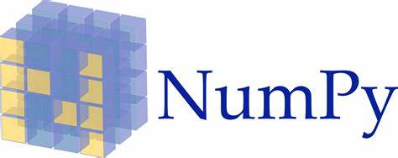


Methodology
Tools:
BeautifulSoup
Google Cloud Big Query, SQL
Scikit-learn, NLTK

Slide 4

Data Extraction
Special Characters, Code,
Links
SQL query from Google Cloud Big Query
Combined 3 tables:user, questions, answers
10M+ data points collected -> filtered to 70k
‘Python’ in title/question
Extract- SQL Query
Google Cloud Big Query
EDA
Standardizing
Preprocessing
Document-Term Matrix
CountVectorizer & TFIDF
Pipeline: spaCy
-Part of Speech Tagger
-Lemmatizer

Slide 5
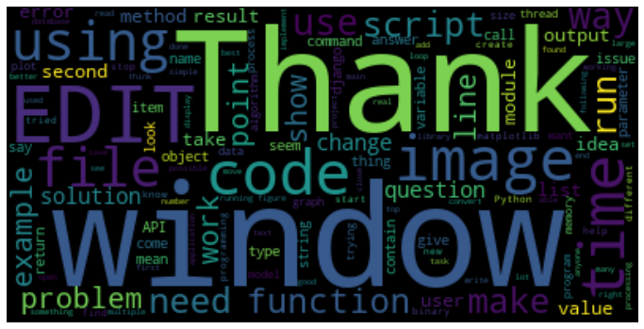
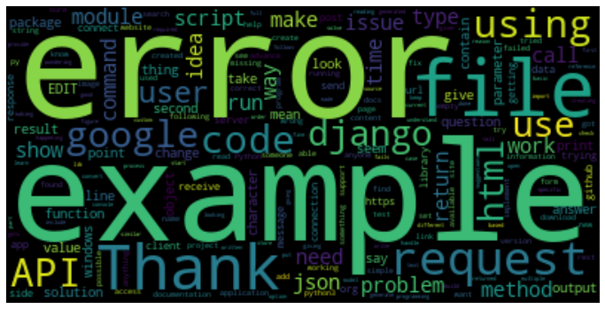
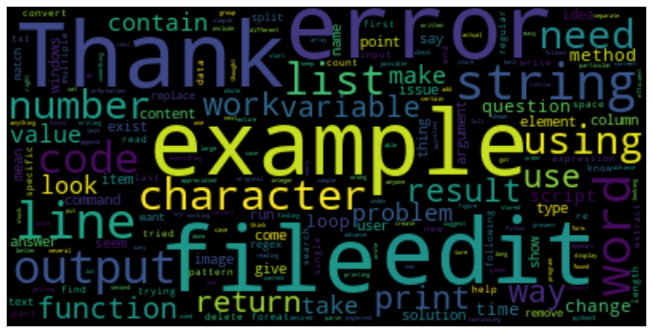
Topic Wordcloud
Topic 0:
image it code time plot using data my have want process there window file way use is images do be thread graph program script need memory size make function get
Plotting,graphing, images
LDA
3 top topic word clouds
Tfidf Vectorizer
Topic 1:
server request client send com using API https requests code response error http my google api app data get connect it connection message django trying Google use post library side
Flask,Django, Server,API, App
Topic 0:
image it code time plot using data my have want process there window file way use is images do be thread graph program script need memory size make function get
Topic 2:
string text file line word regex characters it words want lines have output strings character list split code match using replace remove number expression need search get extract txt pattern
Filtering

Slide 6
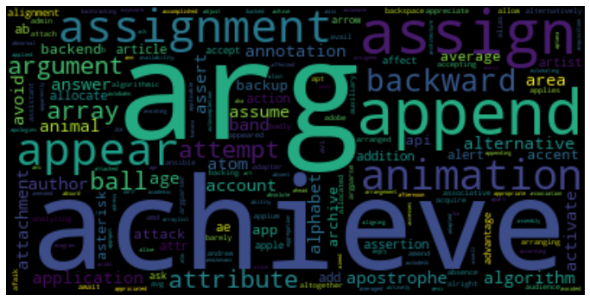
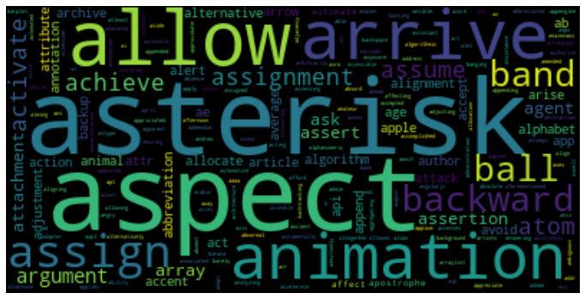
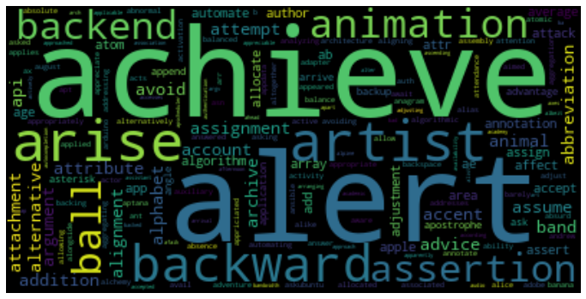
Topic Wordcloud
Topic 0:
amd andrew adapter avi arg b adobe applies alternatively backing arranged avail badly algorithmic backspace ax analyzing amend affects achieve avg alright arranging assistant appreciate append attach apostrophes allocated allow
Analysis
LDA
Count Vectorizer
Topic 1:
type asp adapt asterisk adb b aa amazon aspect adapter aspx ahead amazing applies alphanumeric accessing accidentally adobe allow addr andrew address appended affecting await abc ax arguments ansi atleast
Filtering and Amazon Access
Topic 2:
august automating algorithmic answer balance asked actor andrew balanced backing answered alternatively aptana auth activity ant attention adapter appdata b asn askubuntu appropriate alchemy appreciate associated allow alert aware arduino
Algorithm, Authentication

Slide 7
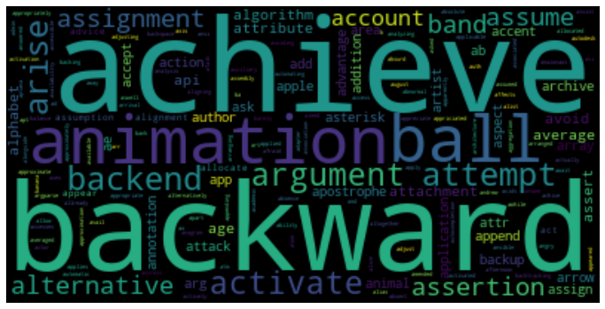
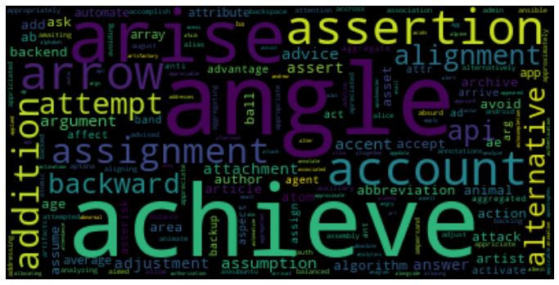
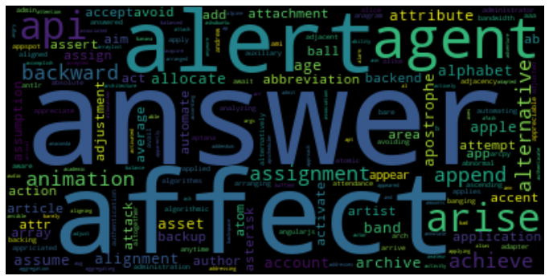
Topic Wordcloud
Topic 0:
andrew allocated adapter affects backspace applies avail august alternatively ax analyzing backing achieve actually backward barely animation b apostrophes appreciate ball appeared aimed arranging avi attempt appending backend appropriate approximate
Analysis, App
NMF
3 top topic word clouds
Count Vectorizer
Topic 1:
ant anti aggregated aggregate alternatively backing advised august backed angle aptana ampersand apis auth allow android ba appropriately appropriate appriciate alice backspace achieve adjust arise attempted advise askubuntu aimed affects
Authentication
Topic 2:
algorithmic algorithms automating artists answer administrator bands answered aware appspot affect andrew alternatively aptana aligned b arrive apply assigns backing ascending applies appriciated arcpy adapter bare appreciate aaa adjacency bandwidth
Algorithm/Automation

Slide 8
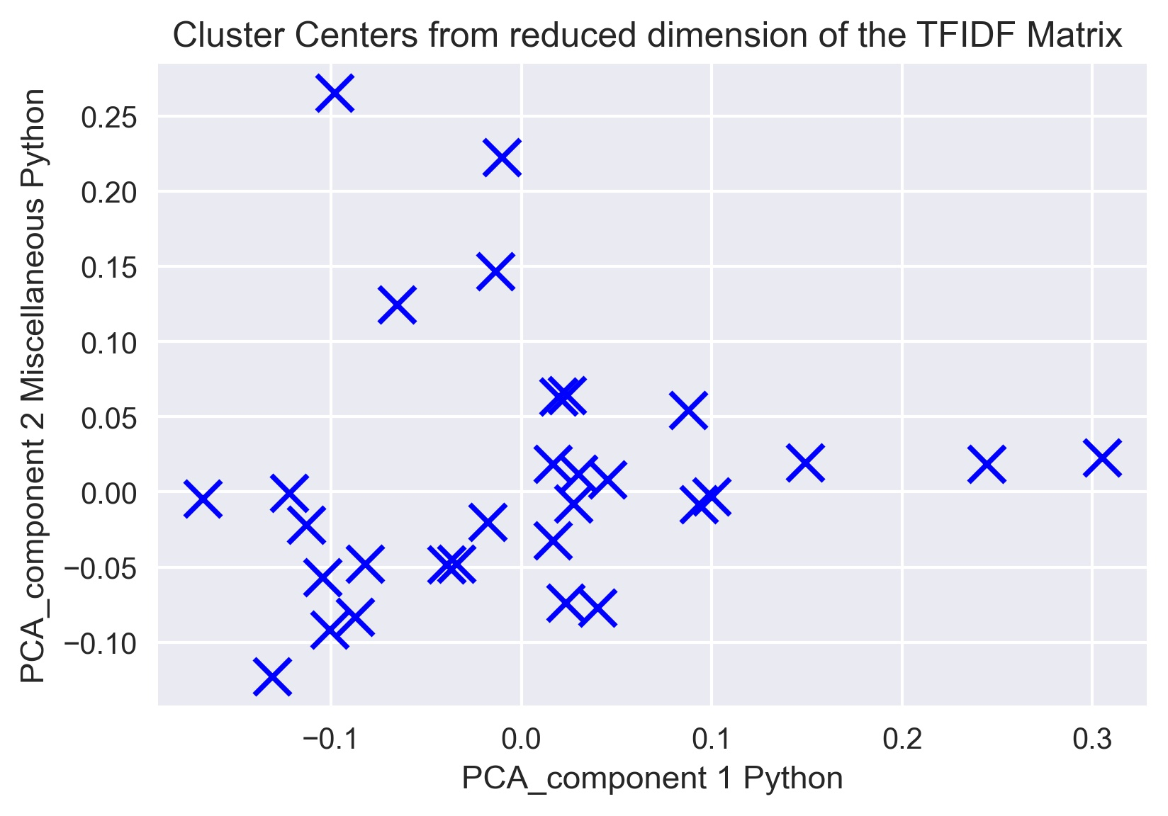
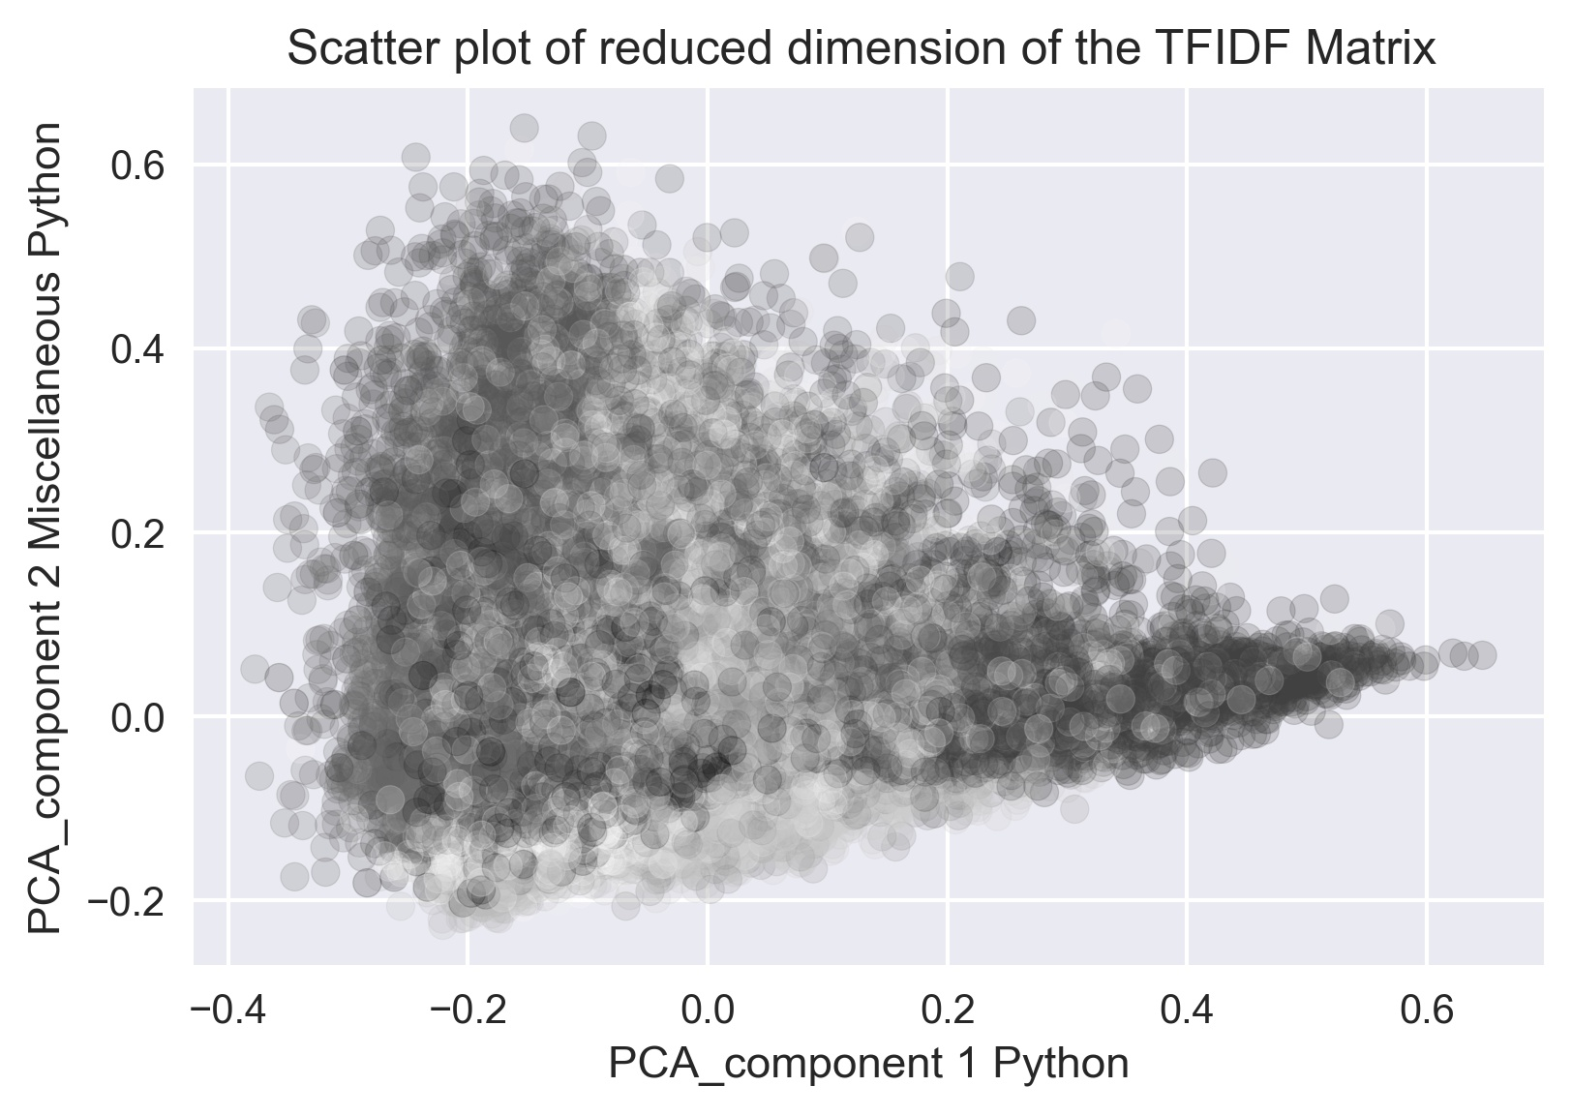
KMeans

Slide 9
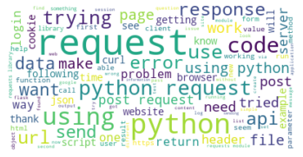
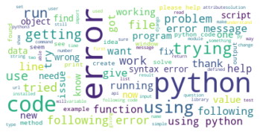
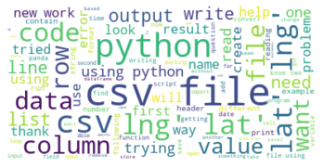
KMeans Word Cloud
Using TFIDF Document Term Matrix
Cluster 0 consists of request, errors, response, api -> most likely web app related such as Flask, Django
Cluster 1 consists of errors, functions, messages, script-> likely python function error related
Cluster 2 consists of file, csv, row, list -> related to python taking in files, writing, cleaning, and filtering

Slide 10
Scores
Homogeneity Score | Silhouette Score
1.0 (didn’t make sense) | 0.0271
Homogeneity Score: 0 to 1, 1 stands for perfect homogeneous labeling
Silhouette Score: -1 to 1, -1 being the worst score, values near 0 indicate overlapping clusters

Slide 11
Content Recommendation
Business can recommend other questions based on the content and question asked.
Topic: API
Topic: Django
Top 5 Similar Topics:
Use, get, google, response, request
Top 5 Similar Topics:
Database, py, app, project, server

Slide 12
Future Work
Streamlit App
Apply analysis to more topics
Improve visualization

Slide 13
Conclusion
Can find similar topics based on the question asked
Find the closest question/topic based on the tags and words
Based on these clusters, may be able to assign closest topic or topics from the cluster to the user

Slide 14
Appendix
Google Cloud Big Query
Stack Overflow
10M+ data points
Combined 3 tables: User, Question, Answer
Data Cleaning:
Combine question and its paragraph
Comb through words and filter for specific words
Clsutering Algorithms:
K-means
DBSCAN

Slide 15
Thank you

